Slide 1
Severe Weather Integrated Response​
Tranche 3 Orders in Council
28 June 2023
Public hui

Slide 2
Karakia
Timatanga
Tuia i runga
Tuia i raro
Tuia i roto
Tuia i waho
Tuia i te here tangata
Ka rongo te pō
Ka rongo te ao
Haumi ē, hui ē, tāiki ē
Stitch the celestial energies
To the terrestrial energies within and without
Bind the kinship strands of humanity
Listen constantly night and day
Draw these matters to a single point, give them substance.
The wisdom is bound, it collects, it is held!

Slide 3
Agenda
Overview of the session
Overview of Orders in Council
Overview of the policy issues and proposals
  Temporary accommodation
  Waste issues
Providing written feedback and next steps
Further discussion

Slide 4
Orders in Council
An overview
Developed under the mechanism in the Severe Weather Emergency Recovery Legislation Act 2023
Adds flexibility to the response, allowing quick regulatory changes to respond to issues as they arise.
Enables the Ministry for the Environment to amend legislation we are responsible for.

Slide 5
Temporary accommodation
Issue
Many households have been displaced from their homes due to the recent severe weather events and those affected urgently require temporary accommodation
Placing temporary accommodation (such as relocatable cabins) close to affected households will breach RMA district plan rules in some instances.
A standard RMA notified resource consent process can be lengthy and create uncertainty for people. Additionally, it creates a resource burden for councils with processing resource consent applications when they are already stretched as they deal with other recovery activities.
Temporary accommodation has been provided through the recovery powers in the Civil Defence Emergency Management Act 2002 (CDEMA). The first national transition period under CDEMA ended on 1 June 2023.

Slide 6
Temporary accommodation
Proposal
Classify temporary accommodation as ‘permitted activity’ under the RMA so that it does not require a resource consent from councils, if it only breaches district plan density standards (including the maximum number of houses per property). People will still need to comply with other district plan rules and other requirements in relevant legislation.
It is for people who have been displaced due to the severe weather events early in 2023 and proposed to cover the affected regions and districts most severely affected.
  Hauraki District
  Tararua District
  Thames-Coromandel District
  Waikato District
  Northland Region
  Auckland Region
  Tairāwhiti Region
  Hawke’s Bay Region
Expected to come into force retrospectively from 1 June 2023 and expire 3 years from enactment.

Slide 7
Temporary accommodation
Permitted activity standards are to be included to manage environmental effects and whether any adverse effects can be avoided, remedied, or mitigated, such as:
  Units must be setback at least 1 metre from any adjacent property boundary.
  The height of the temporary accommodation must not exceed the relevant height limit for buildings in the relevant District Plan.
  Any new vehicle crossing must comply with any sight line requirements in the District Plan.
  All accessways must comply with any width requirements for the number of units in the District Plan or any accessway servicing more than 4 units must be of sufficient width to enable two-way traffic (however no new streets to serve the temporary units are required to be provided).
  All accessways do not need to be permanently sealed but must not create a dust hazard.
  All other rules in the District Plans must be complied with.
  Units will still need to comply with the Building Act, any Reserves Act requirements, any regional council rules, National Environmental Standards under the RMA, and any other district plan rules (for example, the rules protecting significant natural areas, natural hazards, and historic heritage etc).

Slide 8
Waste issues
Issue
The severe weather events have left a significant amount of waste and debris to be managed by individuals, landowners, businesses and councils
Flood and cyclone waste and debris need to be managed efficiently and effectively to enable recovery and rebuild
Existing landfills are limited as to the types and quantities of waste they can take
Consents under the RMA are needed to establish new landfill and storage and sorting facilities, and the process can be lengthy
Proposals are to efficiently establish additional landfill and temporary storage and sorting facilities to manage flood and cyclone waste and debris, while mitigating adverse environmental effects

Slide 9
Waste issues – Proposal 1 (new landfills)
Proposal
Classify establishing new landfills using a tiered approach, given different types of landfills accept different types of waste
  Class 2 and class 3 landfills to be classified as 'controlled activity'
  Class 4 and class 5 landfills to be classified as a 'permitted activity'
Class 1 landfills are not included in the proposal
Geographical scope: proposal to apply to the Hawke's Bay, Auckland, Tairawhiti and Northland regions, and Thames-Coromandel districts
Duration: proposal to apply retrospectively from 1 June 2023, for a period of two years
Proposal would be limited to those sites listed in the Order
Process to add additional sites under the remit of the Order upon application to the Minister

Slide 10
Waste issues – Proposal 2 (temporary storage and sorting facilities)
Proposal
Classify establishing temporary storage and sorting facilities as 'permitted activities'
Geographical scope: proposal to apply to the Hawke's Bay, Auckland, Tairawhiti and Northland regions, and Thames-Coromandel districts
Duration: proposal to apply retrospectively from 1 June 2023, for a period of two years, sites to finish operating and be remediated within five years
Proposal would be limited to those sites listed in the Order
Process to add additional sites under the remit of the Order upon application to the Minister

Slide 11
Waste issues -managing environmental effects
Managing environmental effects
Under the RMA standards and conditions mitigate environmental impacts
We propose the Order sets out matters of control, which could feed into consent conditions
Landfills are sited, designed, operated, and monitored in accordance with the Technical Guidelines for Disposal to Land
The landfill operator shall prepare a Site Management Plan (SMP) that detail the site-specific plans for the construction, operation and decommissioning of a new landfill or the temporary depot or storage facility.
The SMP should include:
Roles and responsibilities of the site management staff
  Contact details for the facility manager
  Procedures for hazard management, including fire hazard, identification, and control:
  Procedures for the management of dust and other airborne contaminants so that they do not spread beyond the site boundary
  Procedures for the management of stormwater, noise, and dust
  Procedure for decommissioning the facility
  Procedures for managing traffic accessing the site
  Identify operating hours for the site

Slide 12
Have your say
  We invite you to provide feedback on these proposals.
  Feedback will be provided to the panel considering these Orders in Council under the Severe Weather Emergency Recovery Legislation Act 2023
  Please email your feedback to severeweather@mfe.govt.nz
  By 5pm Tuesday 4 July

Slide 13
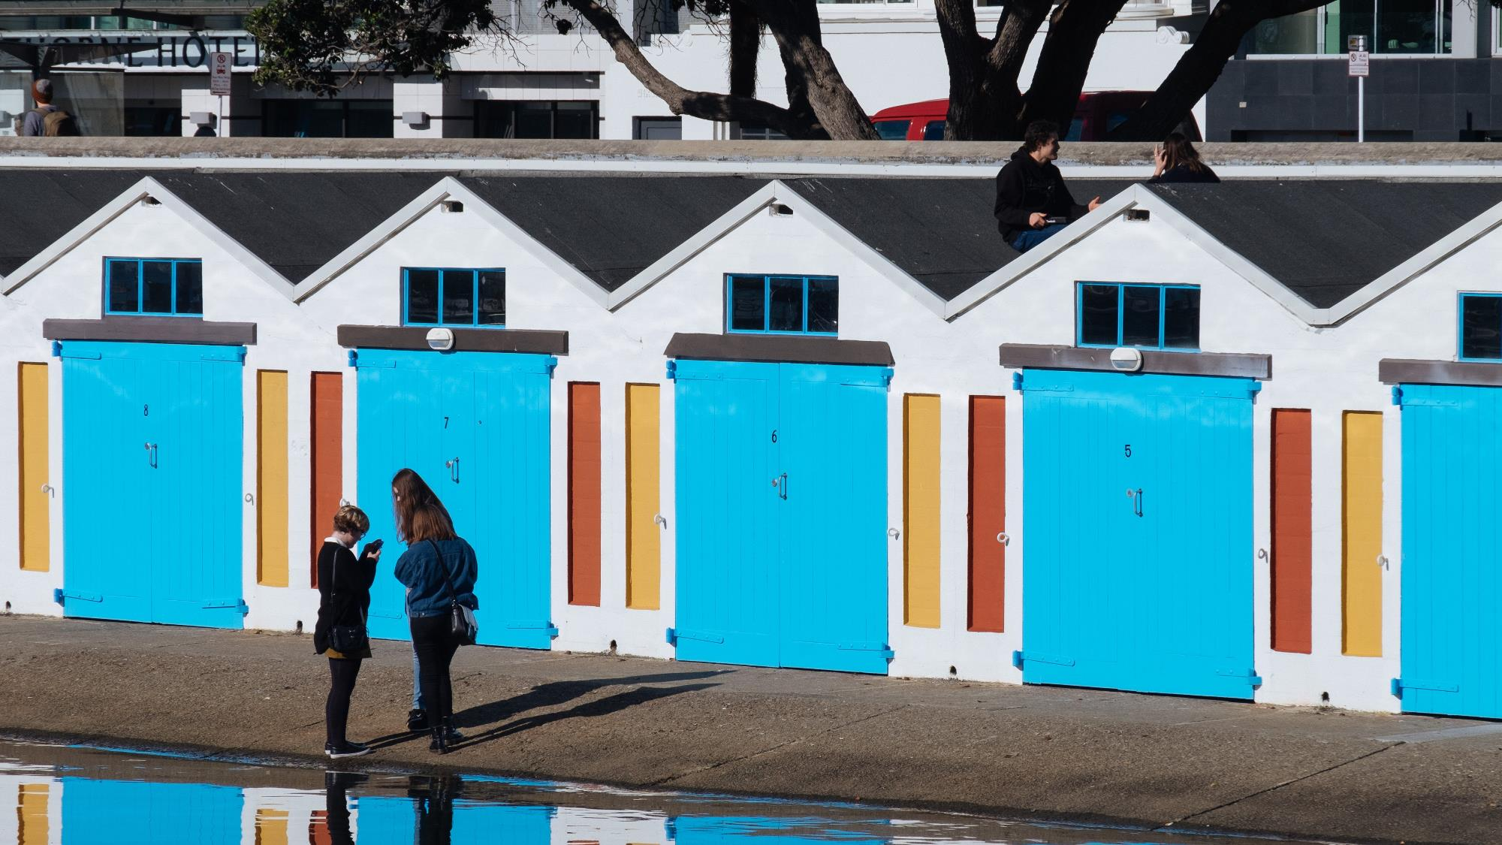
Pātai | Questions?

Slide 14
Karakia
Whakamutunga
Kia whakairia te tapu
Kia wātea ai te ara
Kia turuki whakataha ai
Haumi ē, hui ē, tāiki ē
Restrictions are cast aside
So that the pathway is clear
to return to everyday activities
Uniting as one, uniting in conscious thought!

