Slide 1
West Coast Regional Council meeting with Grey District Council regarding
Taylorville Resource Park Ltd Landfill
Selva Selvarajah

Slide 2
Introduction
TRPL landfill issues and community concerns/complaints have been dealt by both consent authorities, WCRC and GDC
Both councils and council staff at senior and management level have been in communication on numerous occasion
There have been various actions considered by both Councils to address TRPL landfill issues
The purpose of this meeting is for WCRC to update and collaborate on the management of the landfill issues with GDC and its senior staff

Slide 3
Past consent/compliance history
Between 2016 and mid-2021 -The landfill site was under a different ownership with WCRC consent for discharging clean-fill and demolition wastes
Within the above period the site was associated with numerous non-compliances
August 2021 -WCRC land use consents for earthwork and construct and rehabilitate demolition fill site and demolition waste and discharge consent were granted to Infrastructure Consultants followed by consent changes in:
  April 2022 – to discharge asbestos to lined cell
  June 2022- to discharge shredded tyres
W

Slide 4
Past consent/compliance history
August 2022- GDC consents were granted for subdivision and landfill to TRPL
September 2022- WCRC consents were transferred to Taylorville Resource Park Ltd
October 2022- consent change was granted by WCRC to allow discharge of coal tar/coal pitch
W

Slide 5
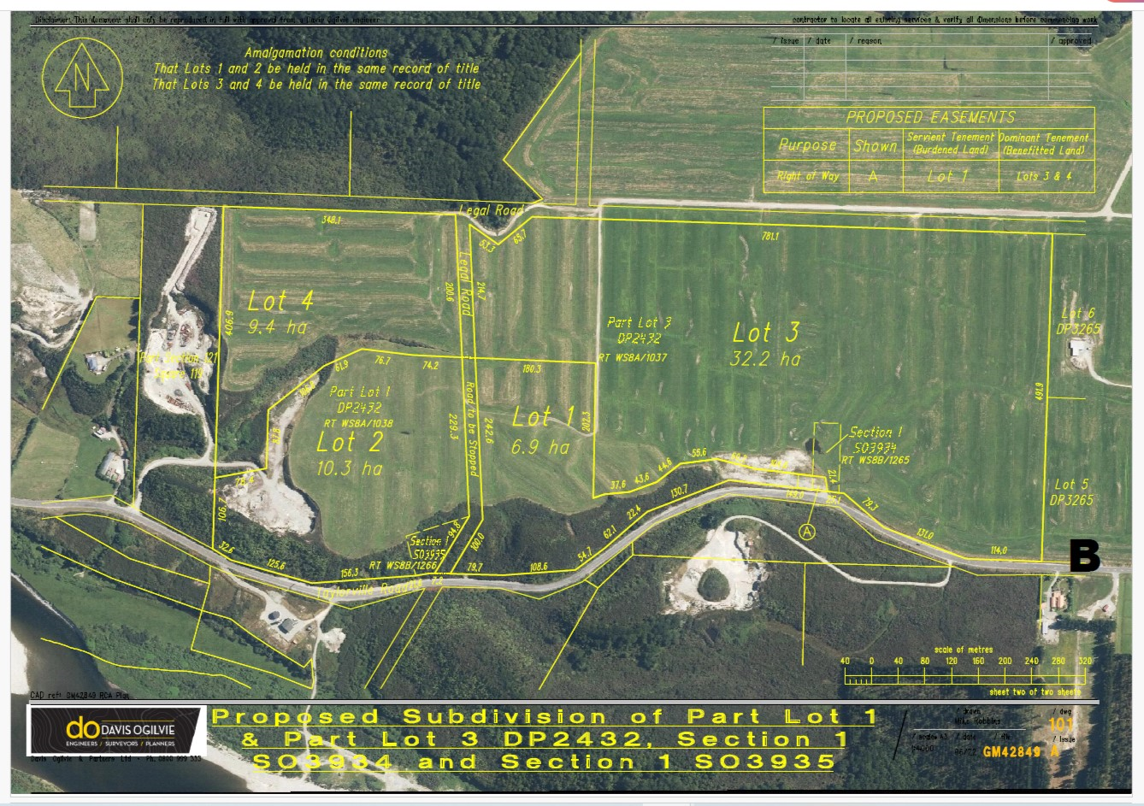
  TRPL Subdivison layout (as per GDC consent)
Notes:
S79 RMA review of policy statements and plans

Slide 6
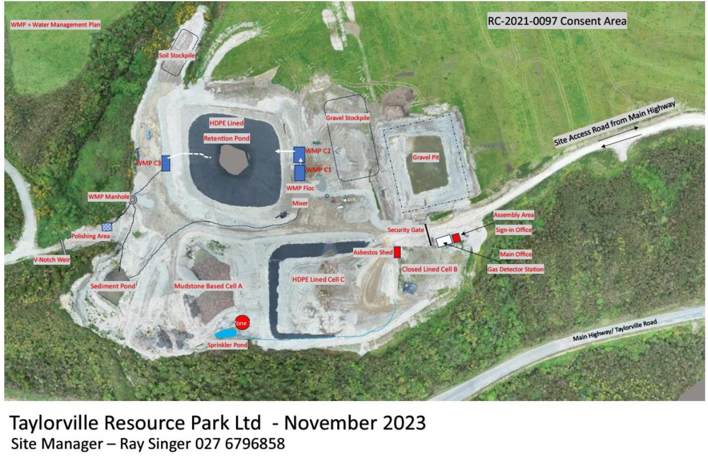
  TRPL landfill layout (as per GDC consent)
Notes:
S79 RMA review of policy statements and plans

Slide 7
Past consent/compliance history
January 2022- With the permission of WCRC, Biosecurity NZ authorised the transportation and discharge of 163 tonnes of virus contaminated tomato plant wastes from Nelson to TRPL landfill
Between February and June 2023- there was evidence of plant wastes (estimated as 400 tonnes) from Nelson (unauthorised by Biosecurity NZ) was being dumped
Biosecurity NZ maintains its explicit authorisation of dumping was only between 24-27 January 2023
W

Slide 8
Past consent/compliance history
April 2023 – First odour complaint was recorded on 15 April
May to July 2023- 11 of the 16 odour complaint visits by WCRC staff found slight odour, on one occasion a moderate odour, and one severe odour detection
July 2023- WCRC served abatement notice to cease odour emission
W

Slide 9
What was the cause of the odour?
Apart from Class 1 MSW (municipal solid waste) landfill no other landfills are allowed to accept putrescible wastes
Putrescible wastes are decomposable organic which can be green, kitchen and biosolid wastes
Organic wastes trigger microbiological reactions which will strip oxygen from the system
Demolition wastes contain gypsum (CaSO₄) with sulphate which can be used as an oxygen source by microbes when mixed with organic wastes thereby converting into smelly hydrogen sulphide (H₂S) gas

Slide 10
What was the cause of the odour?
For the above reason, putrescible wastes are not allowed in fully lined Class 2 C & D (construction & demolition) and unlined Class 3 Managed fills
TRPL landfill has been unclassified
Unlined Class 4 landfill can accept “controlled fill” or with soils with contaminant levels above background levels
Unlined Class 3 landfill can accept “managed fill” soils with greater contaminant levels in addition to “controlled fill”

Slide 11
What was the cause of the odour?
Having failed to find suitable landfill to dispose virus infected tomato plants from Nelson, MPI staff approached WCRC staff
WCRC consent did not ban the discharge of putrescible materials to TRPL landfill
Despite WCRC staff authorising the disposal of the tomato wastes, under the Biosecurity Act process MPI should NOT have requested WCRC authorisation since it was clear TRPL landfill was not only unclassified and not fit for purpose

Slide 12
Past consent/compliance history
April-June 2023- Discharge of contaminated water to drain detected outside the boundary
WCRC’s investigation found that the above discharge was from the sediment pond
W

Slide 13
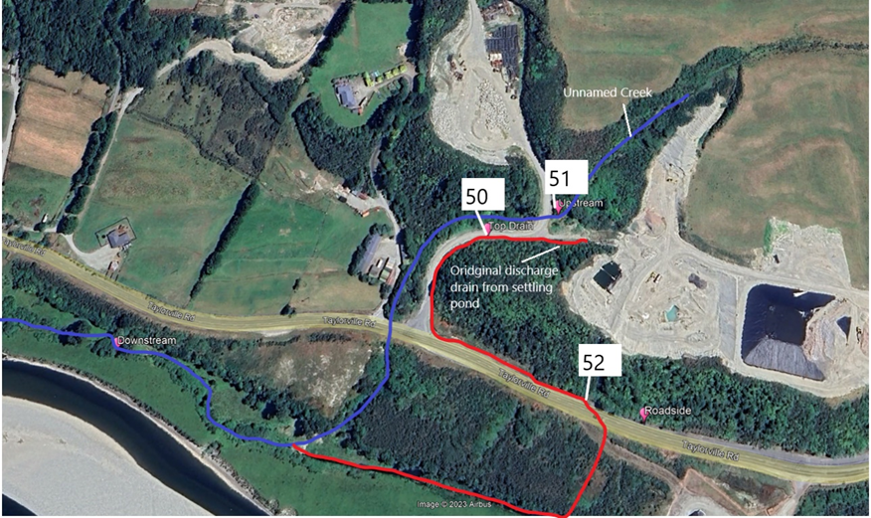
  Leachate discharge pathway in red
Notes:
S79 RMA review of policy statements and plans

Slide 14
  Sampling site No.50 discharge quality on 5 May 2023 comparison with typical raw sewage effluent
Contaminants | Sampling site No.50 | Raw sewage wastewater
Biological oxygen demand (BOD) mg/L | 147 | 250
Chemical oxygen demand (COD) mg/L | 308 | 400
Ammoniacal-nitrogen mg/L | 16.7 | 20-30
Escherichia coli cfu/100 mL | 17000 | 10,000,000
Notes:
S79 RMA review of policy statements and plans

Slide 15
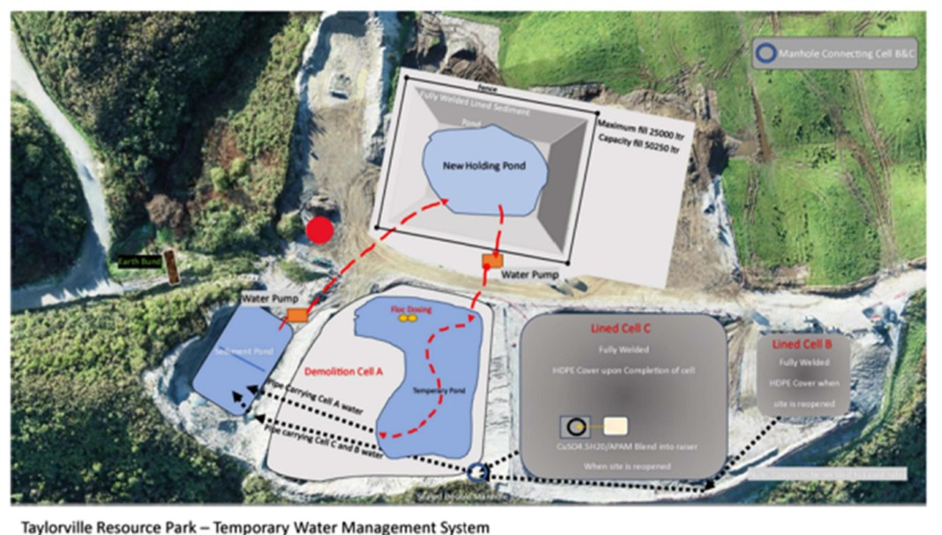
  TRPL dump cells and pond layout
Notes:
S79 RMA review of policy statements and plans

Slide 16
Past consent/compliance history
Between May and October 2023 - consent change for flocculant use was withdrawn and consent change for constructing lined pond and class 3 landfill status were rejected under s88 by WCRC
September 2023 – WCRC issued notice to review consent conditions
Cancelling consent under s132(3) is not easy since there must be a proof of inaccuracies influencing the granting of the consent and there are significant adverse effects from exercising the consent
S128 and s129 review processes are limited to the consent conditions in questions as such not holistic in addressing all landfill issues comprehensively
W

Slide 17
Past consent/compliance history
January 2024 – EPA team visited TRPL site for full investigation
March 2024 - EPA served an abatement notice to direct all landfill leachates to a lined authorized pond or a facility by 14 June 2024
EPA sampled leachate discharges from various points and leachate from the sediment pond itself
Owing to the leachate discharge point being upstream of the GDC water take site, EPA ruled out any risk to the water supply

Slide 18
  EPA sediment pond and downstream leachate sample quality comparison with NZ drinking water standard
  EPA samples 16 & 17 January 2024
Notes:
S79 RMA review of policy statements and plans

Slide 19
What is the potential for downstream contaminated site?
Under the contaminated land NES there must be risk to human because of a subdivision or other land uses specified
Any contaminant must be risky to human because of land use
From the soil chemistry viewpoint, the contaminant levels are not sufficient to cause soil contamination levels exceeding the NES levels
Moreover, no contaminated soils/materials have been authorized to be discharged which could be a source

Slide 20
Resource Management (National Environmental Standard for Assessing and Managing Contaminants in Soil to Protect Human Health) Regulations 2011
Notes:
S79 RMA review of policy statements and plans

Slide 21
Past consent/compliance history
March 2024 – TRPL applied for a variation to gain Class 3 “Managed Fill” status and consents for landfill contaminant discharge to water and landfill gas to air
April 2024 - Under s92(2) WCRC requested TRPL for council commission a report based on 14 points at TRPL’s cost and TRPL had agreed to
Currently the WCRC consultants (PDP) with landfill and hydrogeology expertise have been engaged to complete the reporting which includes site and landfill assessment
Under the Resource Management NES for sources of human drinking regulations (2007) WCRC can also assess any discharge impacts provided the discharge is upstream

Slide 22
Next steps
We understand under the EPA abatement notice TRPL is in the process of commissioning a lined leachate pond to replace the sediment pond
WCRC staff are working with PDP to ensure robust assessment of the status and adverse effects of the landfill which will include offsite adverse effects
We recommend both GDC and WCRC to co-ordinate any consent process or environmental monitoring
Once commissioning of the report is completed WCRC will request additional information from TRPL under s92(1)

Slide 23
Next steps
WCRC will publicly notify the three consents and the hearing and the decision will be by independent commissioners
GDC can conduct its review of the GDC consents and if timely can be processed jointly
Depending on the PDP investigation WCRC may commission offsite groundwater monitoring
GDC could use its own routine water source monitoring for any unusual contaminant elevation

