Slide 1
Nutrient Management Tools
Update
21 Dec 2023

Slide 2
Purpose of this slide deck
To update you on the completion of the OverseerFM review work programme

Slide 3
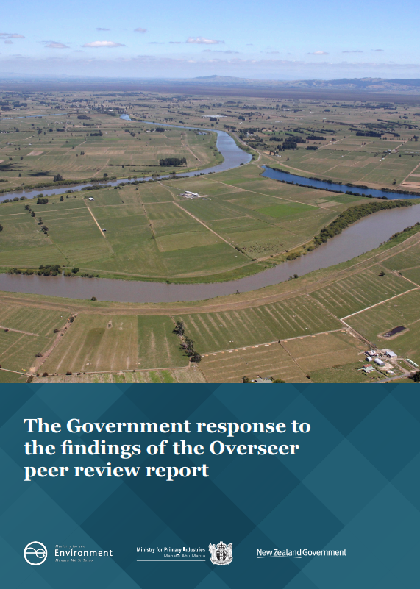
Introduction
Read the report:
Government response to the findings of the Overseer peer review report | Ministry for the Environment

Slide 4
OverseerFM Review

Slide 5
Key messages
The Ministry for Primary Industries led the OverseerFM review programme
They have closed out this programme
Refer to MPI’s website for further information Overseer 2020 review | NZ Government (mpi.govt.nz)
We are updating our guide on Council's use of OverseerFM

Slide 6
Risk Index Tool (RIT) update

Slide 7
Key messages
Dec 2023 update
New vendor on-boarded (March 2023)
Agreement secured for delivering the Operator Portal
RIT moved into MfE’s Freshwater Implementation work programme (Aug 2023)
Road map for consideration for future RIT development (Dec 2023)
Socialisation of the RIT with councils and industry (expected early 2024)
RIT release (28 March 2024)

Slide 8
Phases schedule 2023/2024
2023
2024
Dec
Jan
Feb
Mar
Apr
Onboarding
Risk Calculation Engine testing and remediation
Final RIT build
UAT & remediation
Go-live window
*UAT (User Acceptance Testing). Accreditation and Certification is a systematic procedure for evaluating, testing, and authorising go-live activities, as well as ensuring business as usual (BAU) support and monitoring processes are in place.

Slide 9
Mātauranga Māori

Slide 10
Key messages
Councils are encouraged to engage with tangata whenua to continue to develop and maintain relationships.
These relationships will enable iwi Māori to influence the design, implementation and monitoring of the nutrient management tools being used to achieve desired freshwater outcomes.

Slide 11
Principles, stewardship and governance – rules for tools

Slide 12
Key messages
MfE to own, govern and steward the RIT, in the interim.
MfE is setting up a review group to evaluate nutrient management models and tools for use in different regulatory contexts. The review group's purpose will be to assist and support councils in the lead up to notifying their Land and Water Regional Plans.

Slide 13
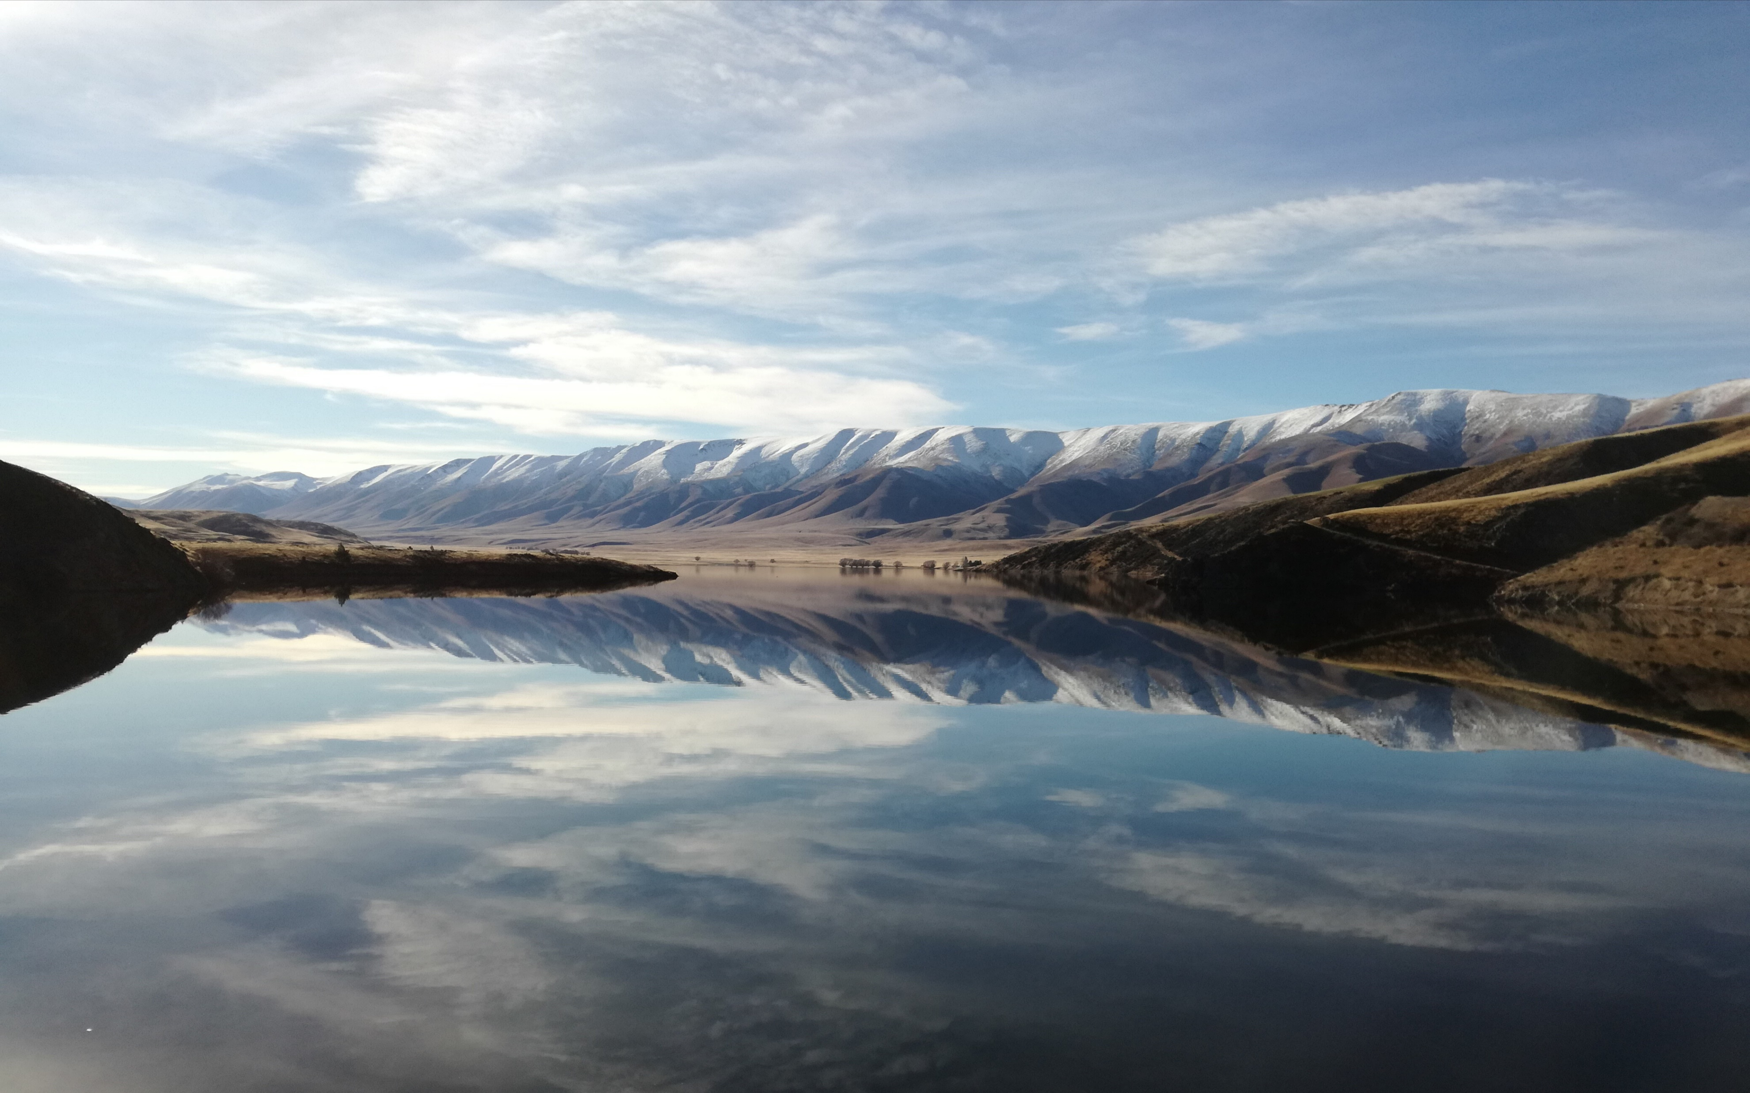
Communications

Slide 14
Communications overview
All RIT communication materials will be published on the MfE website.
Our communication materials are primarily intended for councils.
Anyone with an interest in freshwater policy will be able to read the materials on the MfE website.
Updates will be emailed to our stakeholders from the RIT mailbox.
If you have any queries, please email: riskindextool@mfe.govt.nz

Slide 15
Next steps

Slide 16
Next steps
The government made commitments in response to the Overseer whole-model review
RIT will be released late March, 2024.
MPI have closed out the Overseer redevelopment programme.
MfE will establish a review group to evaluate nutrient management models and tools, including the RIT.
All RIT communication materials will be published on the MfE website.
No one approach is the solution to managing diffuse nutrients. A systems approach, at place, is required.

Slide 17
Contact
If you have any queries, please email: riskindextool@mfe.govt.nz

